Slide 1
CAP442 Web Technology
Unit II
Session 4
II Year M.C.A

Slide 2
Contents
Java Script
Standard Objects
String Objects
Array Objects
Date Objects
Math Object
Window Object
Document Object
Element Objects

Slide 3
Date Object
The Date object is used to work with dates and times.
Date objects are created with new Date().
There are four ways of instantiating a date:
var d = new Date();
var d = new Date(milliseconds);
var d = new Date(dateString);
var d = new Date(year, month, day, hours, minutes, seconds, milliseconds);

Slide 4
Date Object Properties
Property Description
constructor Returns the function that created the Date object's prototype
prototype Allows you to add properties and methods to an object

Slide 5
Date Object Methods
Method Description
getDate() Returns the day of the month (from 1-31)
getDay() Returns the day of the week (from 0-6)
getFullYear() Returns the year
getHours() Returns the hour (from 0-23)
getMilliseconds() Returns the milliseconds (from 0-999)
getMinutes() Returns the minutes (from 0-59)
getMonth() Returns the month (from 0-11)
getSeconds() Returns the seconds (from 0-59)
getTime() Returns the number of milliseconds since midnight Jan 1 1970, and a specified date

Slide 6
Method Description
getTimezoneOffset() Returns the time difference between UTC time and local time, in minutes
getUTCDate() Returns the day of the month, according to universal time (from 1-31)
getUTCDay() Returns the day of the week, according to universal time (from 0-6)
getUTCFullYear() Returns the year, according to universal time
getUTCHours() Returns the hour, according to universal time (from 0-23)
getUTCMilliseconds() Returns the milliseconds, according to universal time (from 0-999)
getUTCMinutes() Returns the minutes, according to universal time (from 0- 59)

Slide 7
Method Description
getUTCMonth() Returns the month, according to universal time (from 0-11)
getUTCSeconds() Returns the seconds, according to universal time (from 0-59)
getYear() Deprecated. Use the getFullYear() method instead
now() Returns the number of milliseconds since midnight Jan 1, 1970
parse() Parses a date string and returns the number of milliseconds since January 1, 1970
setDate() Sets the day of the month of a date object
setFullYear() Sets the year of a date object
setHours() Sets the hour of a date object
setMilliseconds() Sets the milliseconds of a date object

Slide 8
Method Description
setMinutes() Set the minutes of a date object
setMonth() Sets the month of a date object
setSeconds() Sets the seconds of a date object
setTime() Sets a date to a specified number of milliseconds after/before January 1, 1970
setUTCDate() Sets the day of the month of a date object, according to universal time
setUTCFullYear() Sets the year of a date object, according to universal time
setUTCHours() Sets the hour of a date object, according to universal time
setUTCMilliseconds() Sets the milliseconds of a date object, according to universal time

Slide 9
Method Description
setUTCMinutes() Set the minutes of a date object, according to universal time
setUTCMonth() Sets the month of a date object, according to universal time
setUTCSeconds() Set the seconds of a date object, according to universal time
setYear() Deprecated. Use the setFullYear() method instead
toDateString() Converts the date portion of a Date object into a readable string
toGMTString() Deprecated. Use the toUTCString() method instead
toISOString() Returns the date as a string, using the ISO standard
toJSON() Returns the date as a string, formatted as a JSON date
toLocaleDateString() Returns the date portion of a Date object as a string, using locale conventions
toLocaleTimeString() Returns the time portion of a Date object as a string, using locale conventions

Slide 10
Method Description
toLocaleString() Converts a Date object to a string, using locale conventions
toString() Converts a Date object to a string
toTimeString() Converts the time portion of a Date object to a string
toUTCString() Converts a Date object to a string, according to universal time
UTC() Returns the number of milliseconds in a date since midnight of January 1, 1970, according to UTC time
valueOf() Returns the primitive value of a Date object

Slide 11
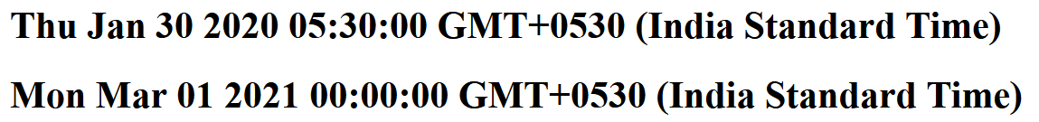
Creating date objects
Examples
<p id="demo2"></p>
<script>
const d2 = new Date("2020-01-30");
document.getElementById("demo2").innerHTML = "<h1>"+d2+"</h1>";
</script>
<p id="demo3"></p>
<script>
const d3 = new Date(2021,2);
document.getElementById("demo3").innerHTML = "<h1>"+d3+"</h1>";
</script>

Slide 12
Date subtraction and comparison
<script type = "text/javascript" >
var date1 = new Date("06/30/2019");
var date2 = new Date("07/30/2019");
var Difference_In_Time = date2.getTime() - date1.getTime();
var Difference_In_Days = Difference_In_Time / (1000 * 3600 * 24);
document.write("<h1>Total number of days between dates <br>"
+ date1 + "<br> and <br>" + date2 + " is: <br> "+ Difference_In_Days) + "</h1>";
document.write("<h1> date1 > date2 "+(date1>date2)+"</h1>")
document.write("<h1> date1 &LT date2 "+(date1<date2)+"</h1>")
</script>

Slide 13
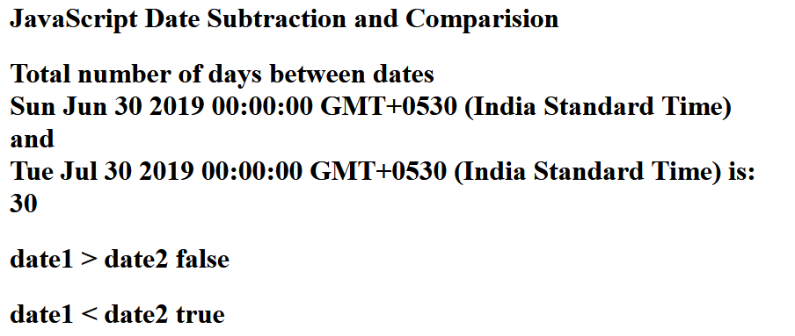
Output:

Slide 14
Accessing components of Date object:
<script>
const d1 = new Date();
document.getElementById("demo1").innerHTML = "<h1>"+d1+"</h1>";
document.write("<h1> Date : "+d1.getDate()+"</h1>");
document.write("<h1> Month : "+d1.getMonth()+"</h1>");
document.write("<h1> Year : "+d1.getYear()+"</h1>");
document.write("<h1> Hours : "+d1.getHours()+"</h1>");
document.write("<h1> Minues : "+d1.getMinutes()+"</h1>");
document.write("<h1> Seconds : "+d1.getSeconds()+"</h1>");
</script>

Slide 15
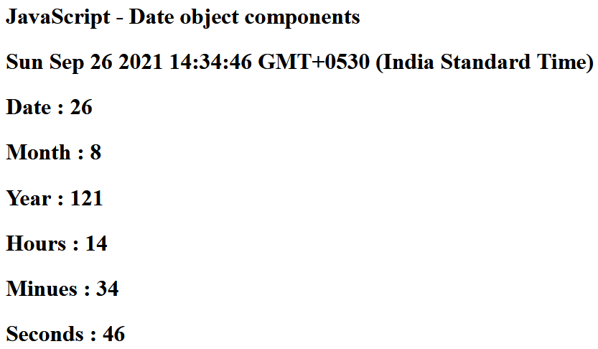

Slide 16
Date subtraction – Get input from user and button click event
<script>
function finddiff(){
var date1 = new Date(document.getElementById("date1").value);
var date2 = new Date(document.getElementById("date2").value);
var Difference_In_Time = date2.getTime() - date1.getTime();
var Difference_In_Days = Difference_In_Time / (1000 * 3600 * 24);
document.write("<h1>Total number of days between dates <br>"
+ date1 + "<br> and <br>"
+ date2 + " is: <br> "
+ Difference_In_Days)+"</h1>";
}
</script>

Slide 17
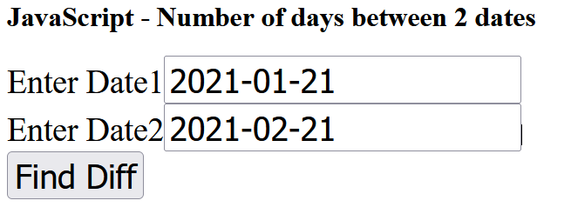
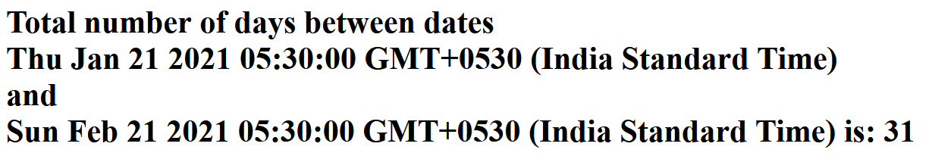
Output:

Slide 18
Math Object
The JavaScript Math object allows you to perform mathematical tasks on numbers.
Example
Math.PI; // returns 3.141592653589793
Unlike other objects, the Math object has no constructor.
The Math object is static.
All methods and properties can be used without creating a Math object first.

Slide 19
Math Properties (Constants)
The syntax for any Math property is : Math.property.
JavaScript provides 8 mathematical constants that can be accessed as Math properties:
Math.E // returns Euler's number
Math.PI // returns PI
Math.SQRT2 // returns the square root of 2
Math.SQRT1_2 // returns the square root of 1/2
Math.LN2 // returns the natural logarithm of 2
Math.LN10 // returns the natural logarithm of 10
Math.LOG2E // returns base 2 logarithm of E
Math.LOG10E // returns base 10 logarithm of E

Slide 20
Math Methods
The syntax for Math any methods is : Math.method(number)
Math Object Methods
Method Description
abs(x) Returns the absolute value of x
acos(x) Returns the arccosine of x, in radians
acosh(x) Returns the hyperbolic arccosine of x
asin(x) Returns the arcsine of x, in radians
asinh(x) Returns the hyperbolic arcsine of x
atan(x) Returns the arctangent of x as a numeric value between -PI/2 and PI/2 radians
atan2(y, x) Returns the arctangent of the quotient of its arguments

Slide 21
Method Description
atanh(x) Returns the hyperbolic arctangent of x
cbrt(x) Returns the cubic root of x
ceil(x) Returns x, rounded upwards to the nearest integer
clz32(x) Returns the number of leading zeros in a 32-bit binary representation of x
cos(x) Returns the cosine of x (x is in radians)
cosh(x) Returns the hyperbolic cosine of x
exp(x) Returns the value of Ex
expm1(x) Returns the value of Ex minus 1
floor(x) Returns x, rounded downwards to the nearest integer

Slide 22
Method Description
fround(x) Returns the nearest (32-bit single precision) float representation of a number
log(x) Returns the natural logarithmof x
log10(x) Returns the base-10 logarithm of x
log1p(x) Returns the natural logarithm of 1 + x
log2(x) Returns the base-2 logarithm of x
max(x, y, z, ..., n) Returns the number with the highest value
min(x, y, z, ..., n) Returns the number with the lowest value
pow(x, y) Returns the value of x to the power of y
random() Returns a random number between 0 and 1

Slide 23
Method Description
round(x) Rounds x to the nearest integer
sign(x) Returns the sign of a number (checks whether it is positive, negative or zero)
sin(x) Returns the sine of x (x is in radians)
sinh(x) Returns the hyperbolic sine of x
sqrt(x) Returns the square root of x
tan(x) Returns the tangent of an angle
tanh(x) Returns the hyperbolic tangent of a number
trunc(x) Returns the integer part of a number (x)

Slide 24
There are 4 common methods to round a number to an integer:
Math.round(x) Returns x rounded to its nearest integer
Math.ceil(x) Returns x rounded up to its nearest integer
Math.floor(x) Returns x rounded down to its nearest integer
Math.trunc(x) Returns the integer part of x (new in ES6)

Slide 25
Examples
Math.ceil()
Math.ceil(x) returns the value of x rounded up to its nearest integer:
Math.ceil(4.9); // returns 5
Math.ceil(4.2); // returns 5
Math.ceil(-4.2); // returns -4
Math.floor()
Math.floor(x) returns the value of x rounded down to its nearest integer:
Math.floor(4.7); // returns 4
Math.floor(4.2); // returns 4
Math.floor(-4.2); // returns -5

Slide 26
Math.pow()
Math.pow(x, y) returns the value of x to the power of y:
Math.pow(8, 2); // returns 64
Math.sqrt()
Math.sqrt(x) returns the square root of x:
Math.sqrt(64); // returns 8
Math.abs()
Math.abs(x) returns the absolute (positive) value of x:
Math.abs(-4.7); // returns 4.7

Slide 27
Math.min() and Math.max()
Math.min() and Math.max() can be used to find the lowest or highest value in a list of arguments:
Math.min(0, 150, 30, 20, -8, -200); // returns -200
Math.max(0, 150, 30, 20, -8, -200); // returns 150
Math.random()
Math.random() returns a random number between 0 (inclusive), and 1 (exclusive):
Math.random(); // returns a random number

Slide 28
Math Object Examples
<script>
document.write("<h1> PI : "+Math.PI+"</h1>");
document.write("<h1> 4 POWER 4: "+Math.pow(4,4)+"</h1>");
document.write("<h1>"+Math.ceil(4.9)+"</h1>"); // returns 5
document.write("<h1>"+Math.ceil(4.7)+"</h1>"); // returns 5
document.write("<h1>"+Math.ceil(4.4)+"</h1>"); // returns 5
document.write("<h1>"+Math.ceil(4.2)+"</h1>"); // returns 5
document.write("<h1>"+Math.ceil(-4.2)+"</h1>"); // returns -4
document.write("<h1>Math.min() and Math.max() can be used to find the lowest or highest value in a list of arguments: Example </h1>");
document.write("<h1> Min "+Math.min(0, 150, 30, 20, -8, -200)+"</h1>"); // returns -200
document.write("<h1> Max "+Math.max(0, 150, 30, 20, -8, -200)+"</h1>"); // returns -200
</script>

Slide 29
